Slide 1


Master Tenant - Airbnb SF
Derrick Humphrey
Brandon Warren
Ari Santiago

Slide 2

Project Motivation
Airbnb hosts set their own prices, but how does one come up with the right price for their property?
If your price is too high, you won’t get any renters and if your price is too low you leave money on the table
Airbnb does offer some guidance, but ultimately the renter decides their minimum price

Slide 3

Business Use
Our goal was to use machine learning libraries and tools to analyze the parameters that determine the value and price of a unit so renters aren’t listing units blindly
Based on the amenities in your property, how much should you charge for you rental?
We used multiple regression to determine which categories can influence the price

Slide 4
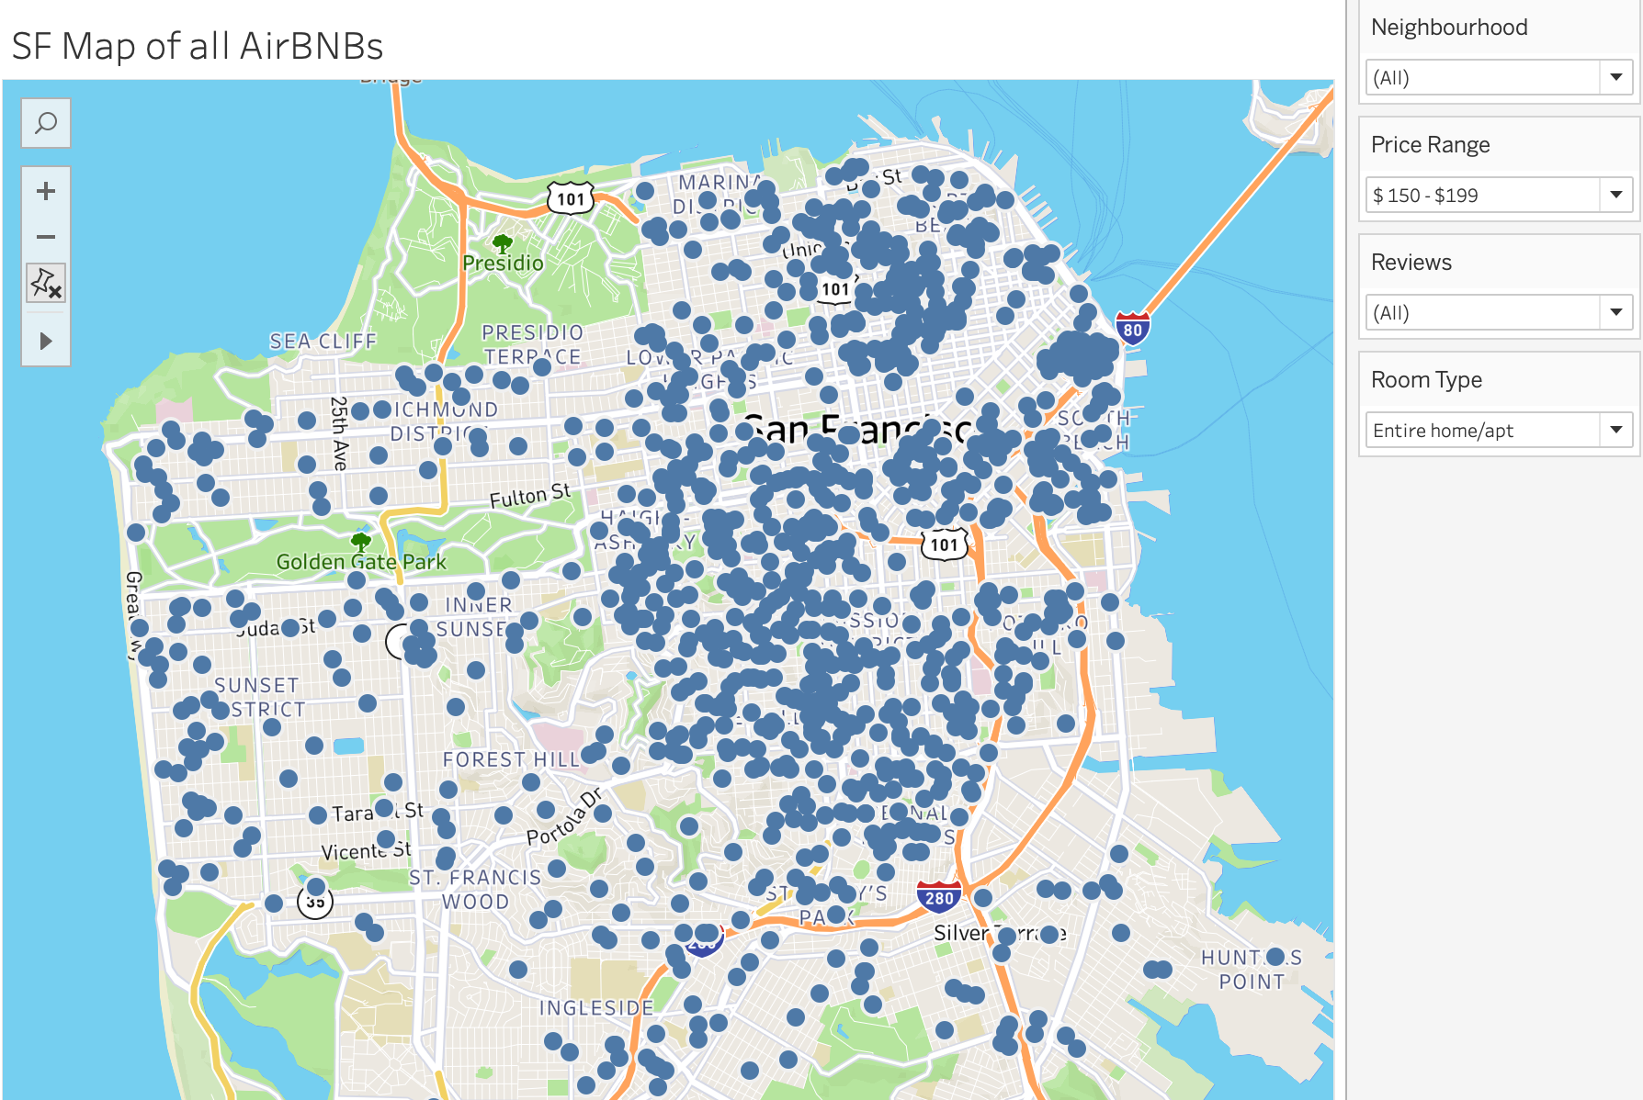
Tableau Visualization and Analysis
Tableau was used to get a broader sense of what was included in the dataset
Latitude and longitude were used to map each of the properties - price, description, and various other variables were in included in the visualizations
When we got to the machine learning portion of the project we used Tableau as a reference to cross check the model

Slide 5
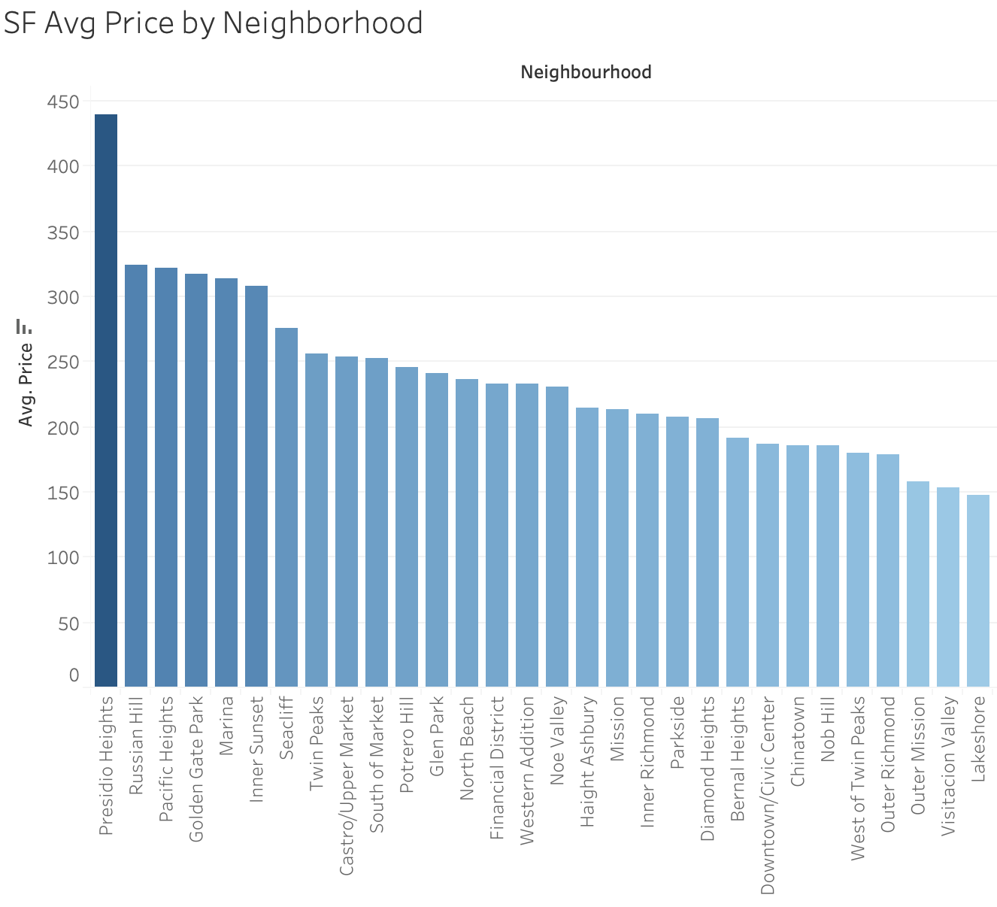
Tableau Visualization and Analysis
We were able to get the average price of each neighborhood in San Francisco to identify the most expensive areas in the city
We created sets that allow users to filter properties by price range and number of reviews
Presidio heights, due to the proximity of the Golden Gate Bridge and the type of listings available was the most expensive neighborhood in San Francisco

Slide 6
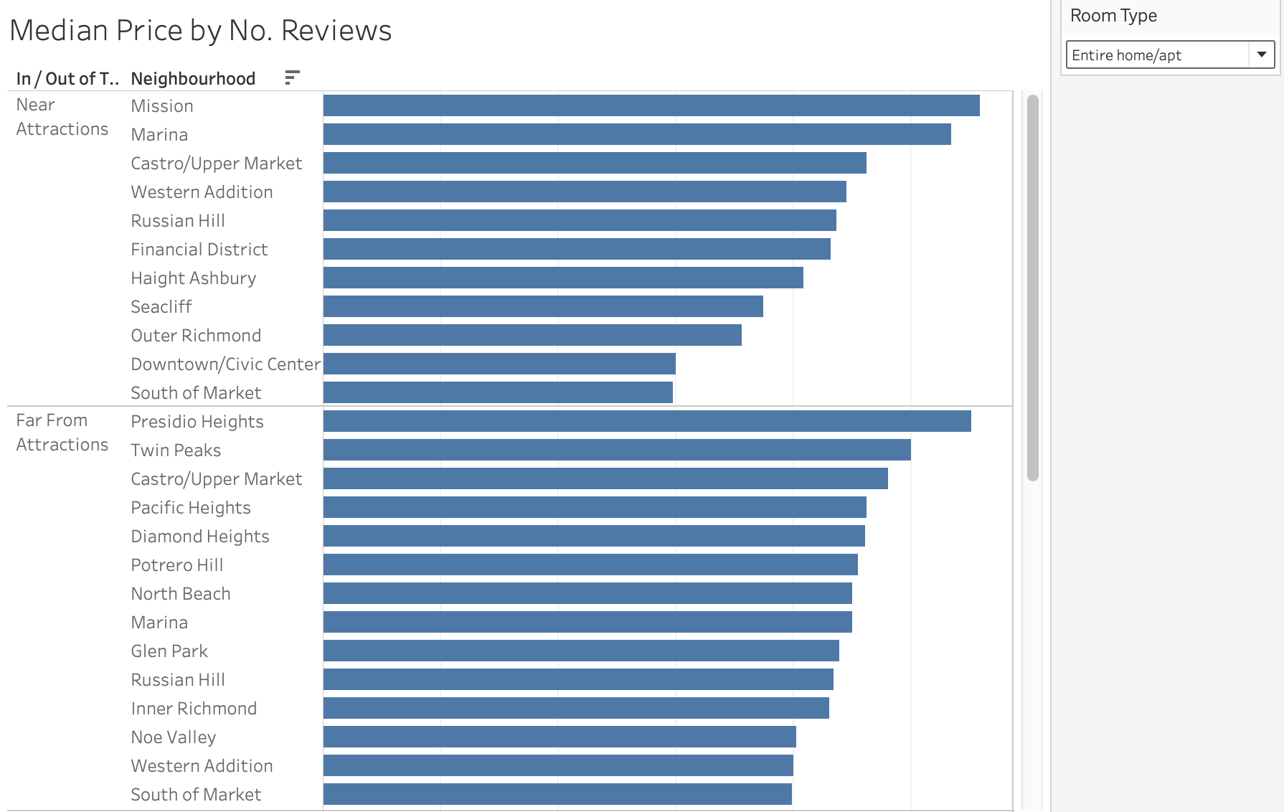
Tableau Visualization and Analysis
Sets were created to identify properties that were within a .25 mile radius of the most popular tourist attractions in San Francisco
We created a median price for each neighborhood and added a filter that allows the user to view the median price of each room type
Sites included:
The Painted Ladies
The Golden Gate Bridge
Dolores Park
SF MOMA
Land’s End

Slide 7
Libraries used
New Libraries!!
GeoPandas is an open source project to make working with geospatial data in python easier. GeoPandas extends the datatypes used by pandas to allow spatial operations on geometric types.
XGboost is a ML library that implements gradient boosting decision tree algorithm.
Pandas
Sklearn
Numpy
matplot
Tableau
Geopandas
XGboost

Slide 8
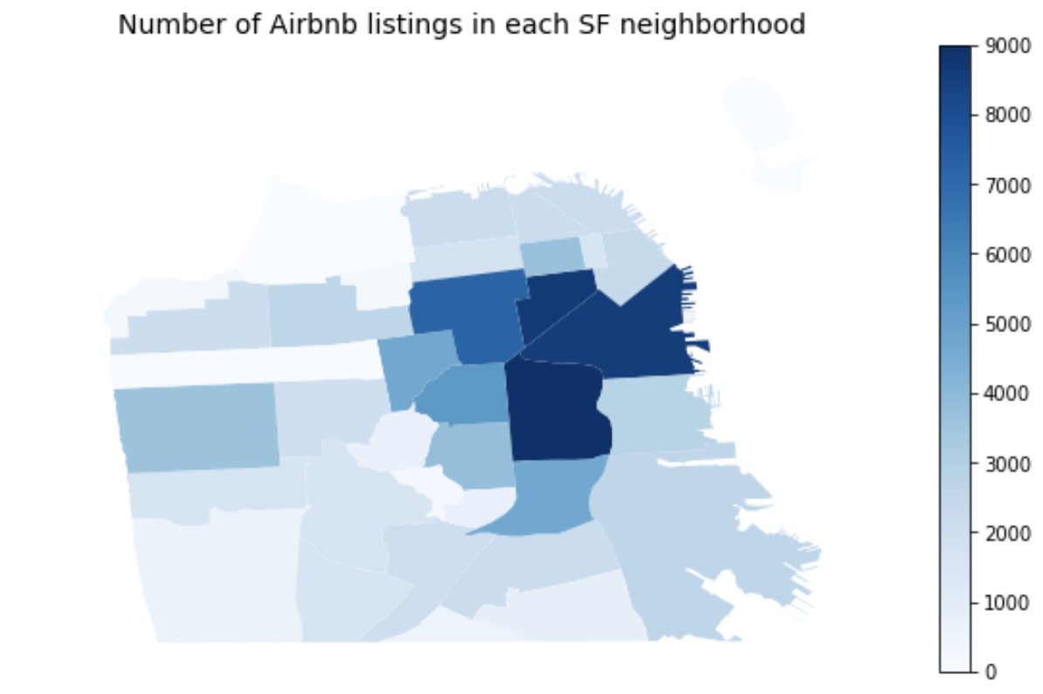
Machine Learning Visualization and Analysis
Top Neighborhoods
Mission District
SOMA
Financial District
Castro
Hayes Valley
Twin Peaks

Slide 9
Machine Learning Visualization and Analysis
XGBoost results:
Training MSE: .1108
Validation MSE: .1297
Training R2: .7716
Validation R2: .7252
Linear Regression:
Training Score: .6391
Testing Score: .6384
Lasso:
MSE: .1791
R2: .6204

Slide 10
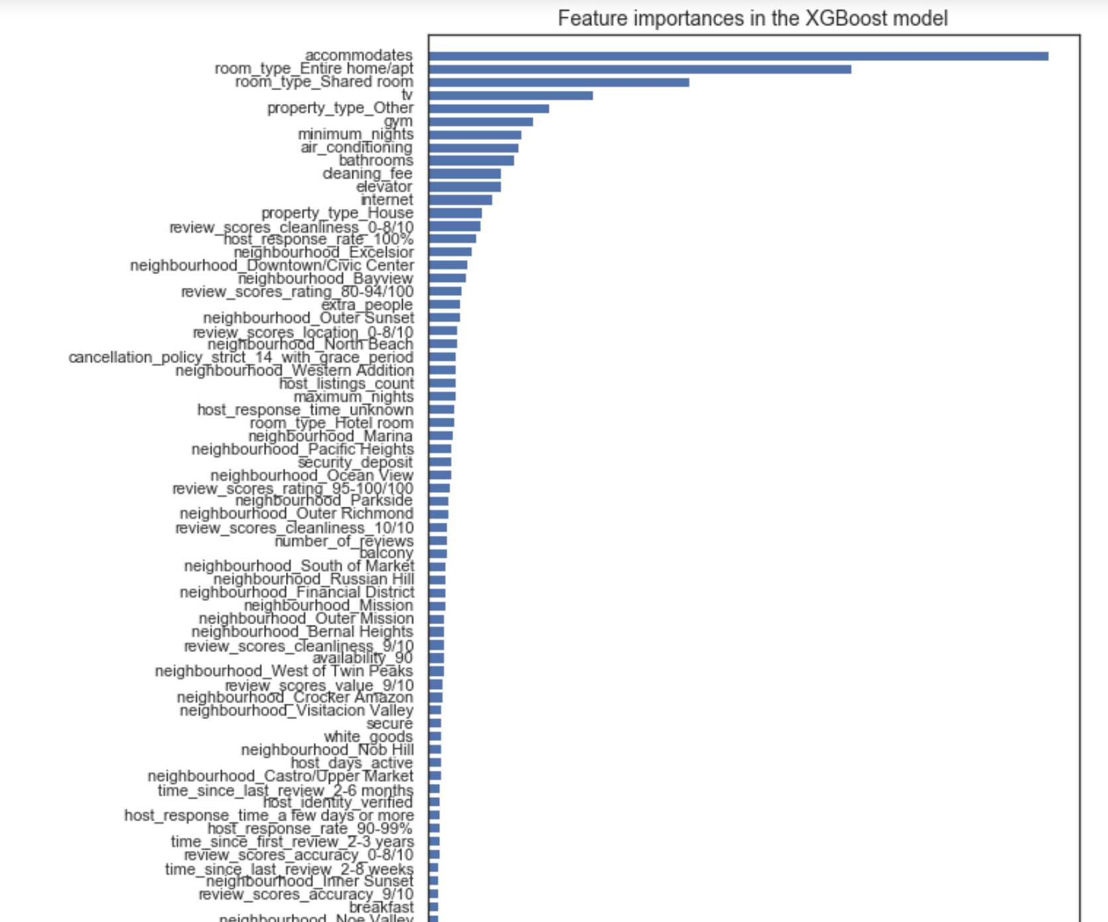
Top Features:
How many people a unit can accommodate
Entire Apt
Shared Room
TV
Property type:other
Gym
Min. Nights
AC
Bathrooms

Slide 11
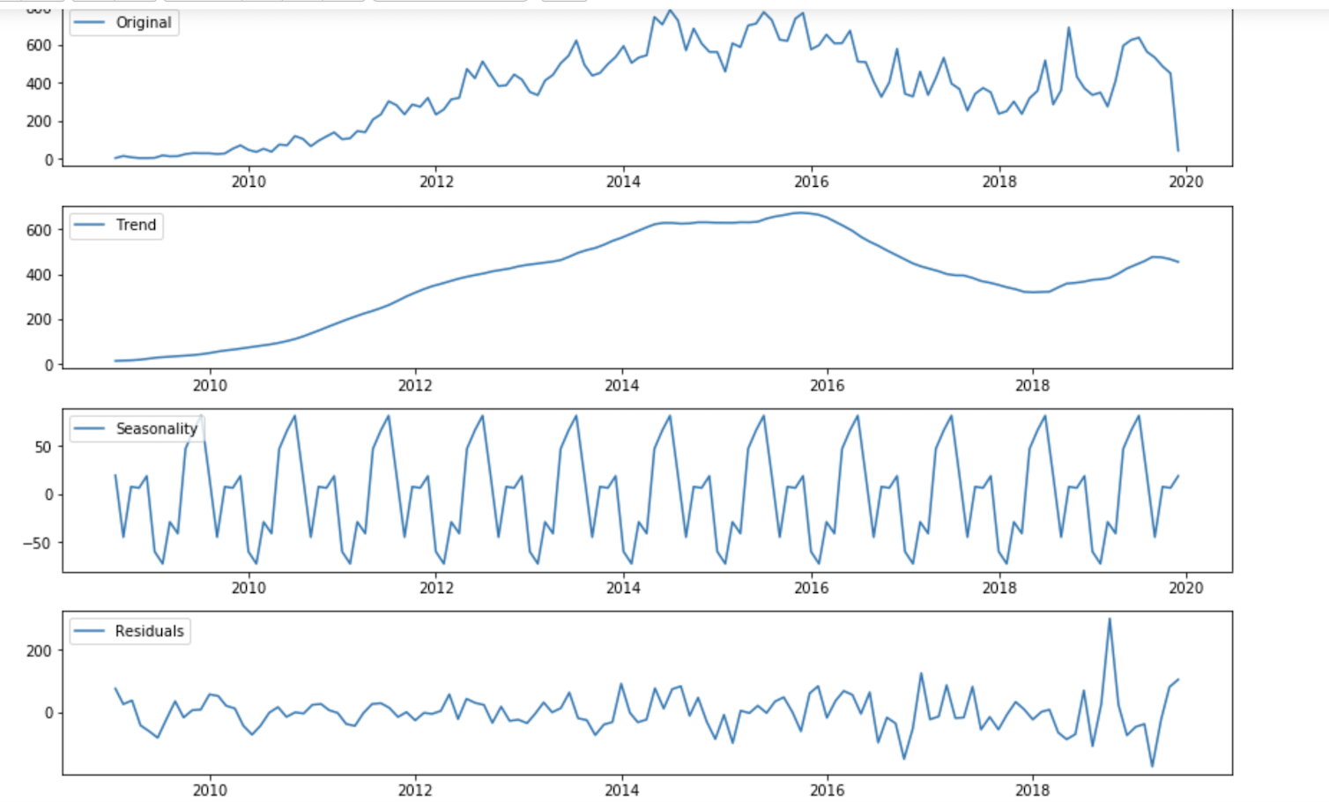
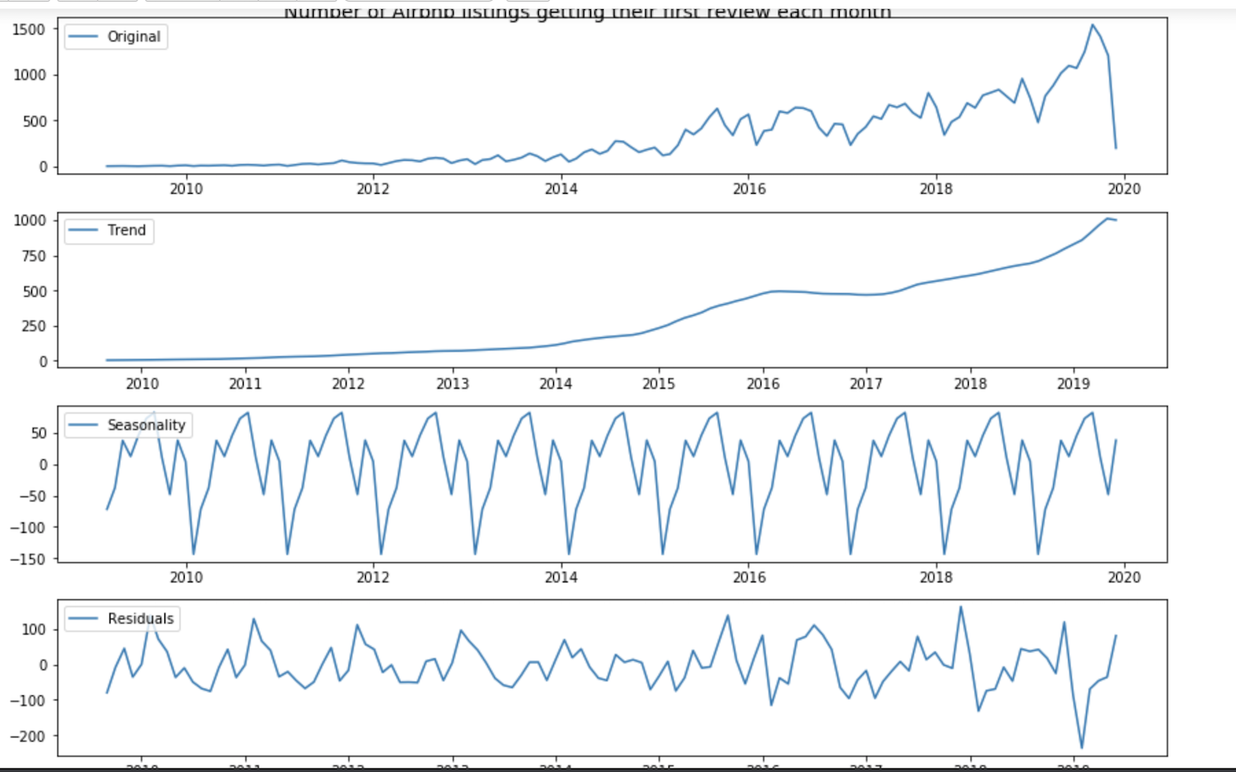
Machine Learning Visualization and Analysis
Number of hosts joining the Airbnb each month/Number of listings getting their first review
Visualization of the number of AirBnb listings getting their first review each month
clear seasonality in the middle of the summer and lowest points at the beginning and end of each year.
Used time series (basically a series of data points ordered in time)
Peak year 2015 (emerged as Airbnb’s largest market company with 25k active hosts

Slide 12

Conclusion
Time (seasonality), location, and description of a listing determine the price of a listing
Machine Learning isn’t a magical black box. How “smart” your data is has a much larger effect than we had expected.
Example: binning reviews and manipulating zeroes for numerical values at the end of our data cleaning process.

Slide 13

Phase 2?
Test the model on other cities to determine consistency.
Produce an HTML based form that would walk a new host through the pricing process.
Incorporate NLP to test the effect/influence of BNB descriptions.

Slide 14

Questions

